Slide 1
CS162 Operating Systems and Systems Programming Lecture 18 Storage Devices, Performance, Queuing Theory

Slide 2
Recall : Simplified IO architecture
Follows a hierarchical structure because of cost: the faster the bus, the more expensive it is

Slide 3
Recall: How does the processor talk to devices?
Remember, it’s all about abstractions!
Device Controller
Interface
(What the OS sees)
Hardware interface device presents to OS
Status
Command
Data
Internals
(What is needed to implement the abstraction)
Hardware interface device presents to OS
Microcontroller
Memory
Other chips

Slide 4
Recall: Device Drivers
Device Driver: Device-specific code in the kernel that interacts directly with the device hardware
Supports a standard, internal interface
Special device-specific configuration supported with the ioctl() system call
Device Drivers typically divided into two pieces:
Top half: accessed in call path from system calls
implements a set of standard, cross-device calls like open(), close(), read(), write(), ioctl(), strategy()
This is the kernel’s interface to the device driver
Top half will start I/O to device, may put thread to sleep until finished
Bottom half: run as interrupt routine
Gets input or transfers next block of output
May wake sleeping threads if I/O now complete
Your body is 90% water, the OS is 70% device-drivers

Slide 5
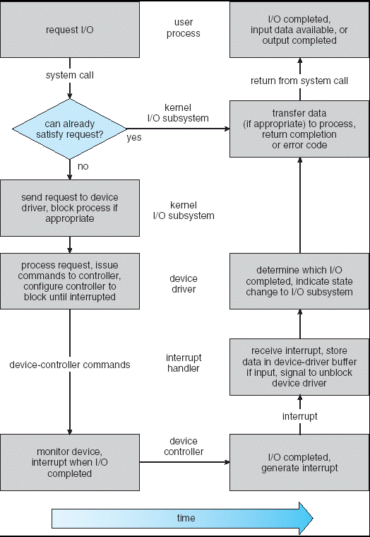
Recall: Life Cycle of An I/O Request
User
Program
Kernel I/O
Subsystem
Device Driver
Top Half
Device Driver
Bottom Half
Device
Hardware

Slide 6
Ways of Measuring Performance: Times (s) and Rates (op/s)
Response Time or Latency - time to complete a task
Measured in units of time (s, ms, us, …, hours, years)
Throughput or Bandwidth – rate at which tasks are performed
Measured in units of things per unit time (ops/s, GFLOP/s)
Start up or Overhead – time to initiate an operation
Most I/O operations are roughly linear in b bytes
Latency(b) = Overhead + b/TransferCapacity

Slide 7
Storage Devices
Magnetic disks
Storage that rarely becomes corrupted
Large capacity at low cost
Block level random access (except for SMR – later!)
Slow performance for random access
Better performance for sequential access
Flash memory
Storage that rarely becomes corrupted
Capacity at intermediate cost (5-20x disk)
Block level random access
Good performance for reads; worse for random writes
Wear patterns issue

Slide 8
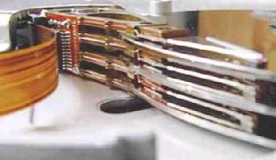
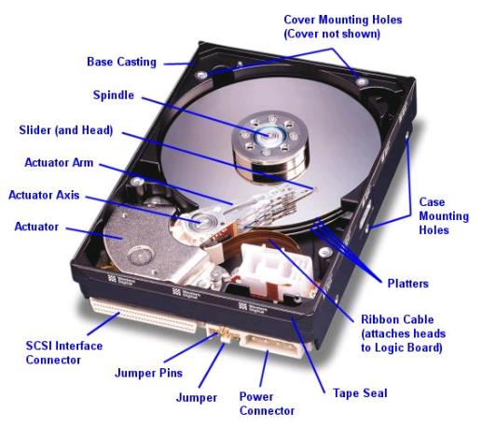
Hard Disk Drives (HDDs)
Read/Write Head Side View
IBM Personal Computer 1986
30MB Hard Disk for 500 dollars

Slide 9
The Amazing Magnetic Disk
Store data magnetically on thin metallic film bonded to rotating disk of glass, ceramic, or aluminum

Slide 10
The Amazing Magnetic Disk
Store data magnetically on thin metallic film bonded to rotating disk of glass, ceramic, or aluminum
Track: concentric circle on surface
Sectors: slice of a track
Smallest addressable unit
Are units of transfers
Cylinder all the tracks under the head at a given point
on all surfaces

Slide 11
The Amazing Magnetic Disk
Track
Sector
Track lengths vary across disk: outside tracks have more sectors per track, higher bandwidth
Disk is organized into regions of tracks with the same number of sector/tracks
Usually, only outer half of radius is used
Head
Cylinder
Platter

Slide 12
The Amazing Magnetic Disk
Read/write data is a three-stage process:
Seek time: position the head/arm over the proper track
Rotational latency: wait for desired sector to rotate under r/w head
Transfer time: transfer a block of bits (sector) under r/w head
Request Time = Queueing Time + Controller Time + Seek + Rotational + Transfer
Software
Queue
(Device Driver)
Hardware
Controller
Media Time
(Seek+Rot+Xfer)
Request
Result

Slide 13
Typical Numbers for Magnetic Disk
Parameter | Info/Range
Space/Density | Space: 14TB (Seagate), 8 platters, in 3½ inch form factor! Areal Density: ≥ 1 Terabit/square inch! (PMR, Helium, …)
Average Seek Time | Typically 4-6 milliseconds
Average Rotational Latency | Most laptop/desktop disks rotate at 3600-7200 RPM (16-8 ms/rotation). Server disks up to 15,000 RPM. Average latency is halfway around disk so 4-8 milliseconds
Controller Time | Depends on controller hardware
Transfer Time | Typically 50 to 250 MB/s. Depends on: Transfer size (usually a sector): 512B – 1KB per sector Rotation speed: 3600 RPM to 15000 RPM Recording density: bits per inch on a track Diameter: ranges from 1 in to 5.25 in
Cost | Used to drop by a factor of two every 1.5 years (or faster), now slowing down

Slide 14
Disk Performance Example
Key to using disk effectively (especially for file systems) is to minimize seek and rotational delays
Assumptions:
Ignoring queuing and controller times for now
Avg seek time of 5ms,
7200RPM ⇒ Time for rotation: 60000 (ms/min) / 7200(rev/min) ~= 8ms
Transfer rate of 50MByte/s, block size of 4Kbyte ⇒ 4096 bytes/50×10⁶ (bytes/s) = 81.92 × 10⁻⁶ sec ≅ 0.082 ms for 1 sector

Slide 15
Disk Performance Example
Read block from random place on disk (random reads):
Seek (5ms) + Rot. Delay (4ms) + Transfer (0.082ms) = 9.082ms
Approx 9ms to fetch/put data: 4096 bytes/9.082×10⁻³ s ≅ 451KB/s
Read block from random place in same cylinder:
Rot. Delay (4ms) + Transfer (0.082ms) = 4.082ms
Approx 4ms to fetch/put data: 4096 bytes/4.082×10⁻³ s ≅ 1.03MB/s
Read next block on same track (sequential reads):
Transfer (0.082ms): 4096 bytes/0.082×10⁻³ s ≅ 50MB/sec

Slide 16
Lots of Intelligence in the Controller
Sectors contain sophisticated error correcting codes
Disk head magnet has a field wider than track
Hide corruptions due to neighboring track writes
Sector sparing
Remap bad sectors transparently to spare sectors on the same surface
Slip sparing
Remap all sectors (when there is a bad sector) to preserve sequential behavior
Track skewing
Sector numbers offset from one track to the next, to allow for disk head movement for sequential ops

Slide 17
Hard Drive Prices over Time

Slide 18
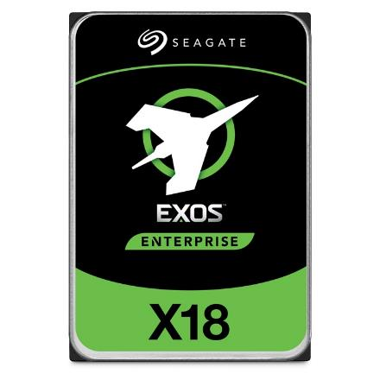
Example of Current HDDs
Seagate Exos X18 (2020)
18 TB hard disk
9 platters, 18 heads
Helium filled: reduce friction and power
4.16ms average seek time
4096 byte physical sectors
7200 RPMs
Dual 6 Gbps SATA /12Gbps SAS interface
270MB/s MAX transfer rate
Cache size: 256MB
Price: $ 562 (~ $0.03/GB)
IBM Personal Computer/AT (1986)
30 MB hard disk
30-40ms seek time
0.7-1 MB/s (est.)
Price: $500 ($17K/GB, 340,000x more expensive !!)

Slide 19
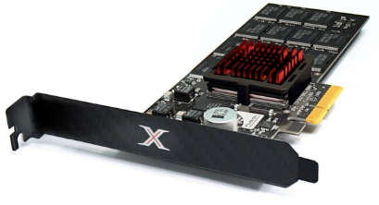
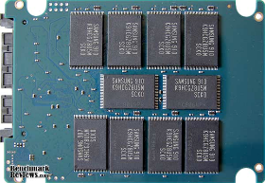
Solid State Drives
1995 – Replace rotating magnetic media with non-volatile memory (battery backed DRAM)
2009 – Use flash memory
Sector (4 KB page) addressable, but stores 4-64 “pages” per memory block
Trapped electrons distinguish between 1 and 0
No moving parts (no rotate/seek motors)
Eliminates seek and rotational delay (0.1-0.2ms access time)
Very low power and lightweight
Limited “write cycles”
Rapid advances in capacity and cost ever since!

Slide 20
The Flash Cell
Encode bit by trapping electrons into a cell
Single-level cell (SLC)
Single bit is stored within a transistor
Faster, more lasting (50k to 100k writes before wear out)
Multi-level cell (MLC)
Two/three bits are encoded into different levels of charge
Wear out much faster (1k to 10k writes)

Slide 21
Of banks, blocks, cells
Flash chips organized in banks
Banks can be accessed in parallel
Blocks: 128 KB/256KB
(64 to 258 pages)
Pages: Few KB
Cells: 1 to 4 bits
Distinction between blocks and pages important in operations!
Bank
Block
Block
Page
Page
Page
Page
Cell
Cell
Cell
Cell
Cell
Cell
Cell
Cell
Cell
Cell
Cell
Cell
Cell
Cell
Cell
Cell

Slide 22
Low-level flash operations
How do you read?
Chip supports reading pages
10s of microseconds, independently of the previously read page
What about writing? More complicated!
Must first erase the block
Erase quite expensive (milliseconds)
Once block has been erased, can then program a page
Change 1s to 0s within a page.
100s of microseconds.
Blocks can only be erased a limited number of times!

Slide 23
Low-level flash operations
INVALID
ERASED
VALID

Slide 24
Low-level flash operations
Assume block of 4 pages. All valid. Want to write Page 0
Step 1: erase full block
Step 2: program page 0

Slide 25
SSD Architecture
Recall that SSDs uses low-level Flash operations to provide same interface as HDD
read and write chunk (4KB) at a time
Reads are easy, but for writes, can only overwrite data one block (256KB) at a time!
Why not just erase and rewrite new version of entire 256KB block?
Erasure is very slow (milliseconds)
Each block has a finite lifetime, can only be erased and rewritten about 10K times
Heavily used blocks likely to wear out quickly

Slide 26
SSD Architecture (Simplified)

Slide 27
Flash Translation Layer (FTL)
Add a layer of indirection: the flash translation layer
Translates request for logical blocks (device interface) to low-level Flash blocks and pages
Goal: performance and reliability
Reduce write amplification
Ratio of the total write traffic in bytes issues by the flash chip by the FTL devided by the total write traffic issued by the OS to the device
Avoid wear out
A single block should not be erased too often

Slide 28
FTL – Two Systems Principles
FTL uses indirection and copy-on-write
Maintains mapping tables in DRAM
Map virtual block numbers (which OS uses) to physical page numbers (which flash mem. controller uses)
Can now freely relocate data w/o OS knowing
Copy on Write/ Log-structured FTL
Don’t overwrite a page when OS updates its data
Instead, write new version in a free page
Update FTL mapping to point to new location

Slide 29
FTL – Two Systems Principles
FTL uses indirection and copy-on-write
Maintains mapping tables in DRAM
Map virtual block numbers (which OS uses) to physical page numbers (which flash mem. controller uses)
Can now freely relocate data w/o OS knowing
Copy on Write/ Log-structured FTL
Don’t overwrite a page when OS updates its data
Instead, write new version in a free page
Update FTL mapping to point to new location

Slide 30
FTL Example
Mapping Table:
Mapping Table
a0->0,0
Mapping Table:
a0->0,0/a1->0,1
Initial
State
Block 0
Block 1
Block 0
Block 1
Write(a1)
Block 0
Block 1
Write(a0)
a0
a0
a1
E
E
E
E
V
E
E
E
V
V
E
E
Mapping Table:
a0->0,0/a1->1,0
Mapping Table:
a0->1,1/a1->1,0
Mapping Table:
a0->1,1/a1->1,0
Write(a1)
Block 0
Block 1
Write(a1)
Block 0
Block 1
Garbage Collect
Block 0
Block 1
a0
a1
a1
a0
a1
a1
a0
a1
a0
V
V
V
E
V
V
V
V
E
E
V
V

Slide 31
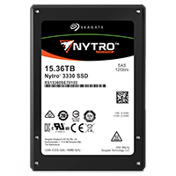
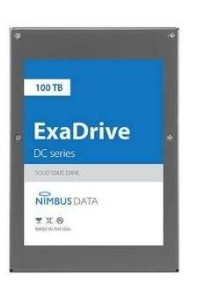
Some “Current” (large) 3.5in SSDs
Seagate Exos SSD: 15.36TB (2017)
Seq reads 860MB/s
Seq writes 920MB/s
Price (Amazon): $5495 ($0.36/GB)
Nimbus SSD: 100TB (2019)
Seq reads/writes: 500MB/s
Random Read Ops (IOPS): 100K
Unlimited writes for 5 years!
Price: ~ $40K? ($0.4/GB)
However, 50TB drive costs $12500 ($0.25/GB)

Slide 32
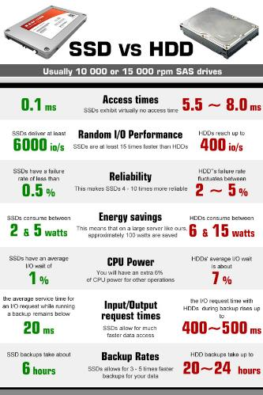
HDD vs. SSD Comparison
HDD | SDD
Require seek + rotation | No seeks
Not parallel (one head) | Parallel
Brittle (moving parts) | No moving parts
Random reads take 10s milliseconds | Random reads take 10s microseconds
Slow (Mechanical) | Wears out
Cheap/large storage | Expensive/smaller storage

Slide 33
Recall: Overall Performance for I/O Path
Controller
User
Thread
Performance of I/O subsystem
Metrics: Response Time, Throughput
Contributing factors to latency:
Software paths (can be loosely modeled by a queue)
Hardware controller
I/O device service time
Queuing behavior:
Can lead to big increases of latency as utilization increases
Solutions?
I/O
device
Queue
[OS Paths]
Response Time = Queue + I/O device service time
300
Response
Time (ms)
200
100
0
0%
100%
Throughput (Utilization)
(% total BW)

Slide 34
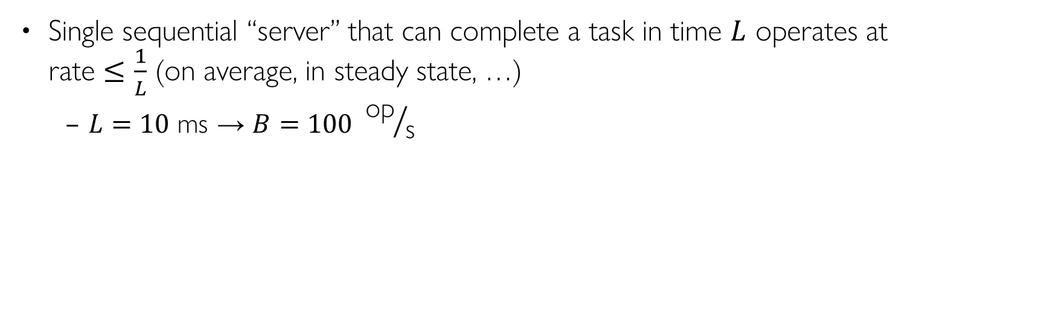
Sequential Server Performance
L
L
L
L
…
L
time
Single sequential “server” that can complete a task in time $L$ operates at rate $≤\frac{1}{L}$ (on average, in steady state, …)
$L=10 \text{ms}$ → $B=100 {\text{op}}/{\text{s}}$

Slide 35
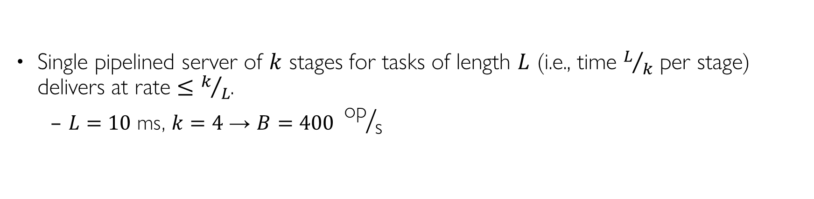
Single Pipelined Server
L
L
divided over distinct resources
logical operation
L
L
L
L
L
L
L
…
time
Single pipelined server of $k$ stages for tasks of length $L$ (i.e., time $L/k$ per stage) delivers at rate $≤k/L$.
$L=10 \text{ms}$, $k=4$ → $B=400 {\text{op}}/{\text{s}}$

Slide 36
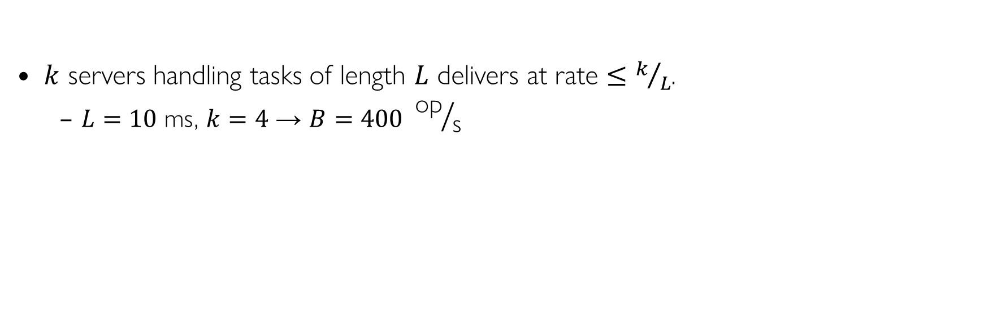
Multiple Servers
L
…
k
$k$ servers handling tasks of length $L$ delivers at rate $≤k/L$.
$L=10 \text{ms}$, $k=4$ → $B=400 {\text{op}}/{\text{s}}$

Slide 37
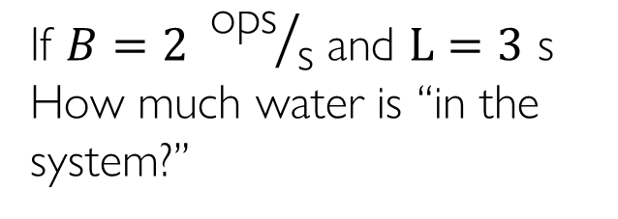
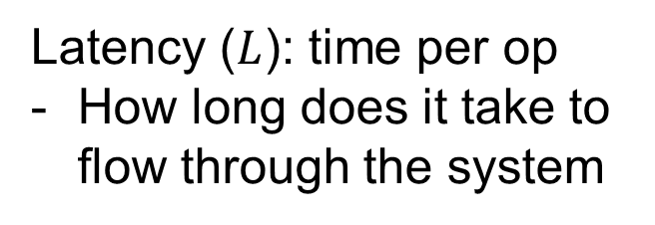
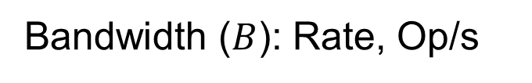
A Simple Systems Performance Model
Latency ($L$): time per op
How long does it take to flow through the system
Bandwidth ($B$): Rate, Op/s
e.g., flow: gal per min
If $B=2 {\text{ops}}/{\text{s}}$ and $L=3 \text{s}$
How much water is “in the system?”

Slide 38
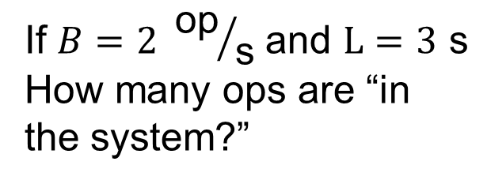
A Simple Systems Performance Model
Latency ($L$): time per op
How long does it take to flow through the system
Bandwidth ($B$): Rate, Op/s
e.g., flow: gal per min
If $B=2 {\text{op}}/{\text{s}}$ and $L=3 \text{s}$
How many ops are “in the system?”

Slide 39
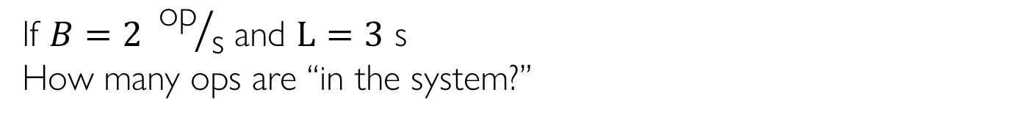
A Simple Systems Performance Model
If $B=2 {\text{op}}/{\text{s}}$ and $L=3 \text{s}$
How many ops are “in the system?”
B=1/3
B=2/3
B=1
B=4/3
B=5/3s
B=2

Slide 40
Little’s Law (B ⇒ $λ$)
N
arrivals
departures
λ
L
In any stable system
Average arrival rate = Average departure rate
The number of “things” in a system is equal to the bandwidth times the latency (on average)
N (jobs) = λ (jobs/s) x L (s)
Applies to any stable system
Can be applied to an entire system:
Including the queues, the processing stages, parallelism, whatever
Or to just one processing stage:
i.e., disk I/O subsystem, queue leading into a CPU or I/O stage, …

Slide 41
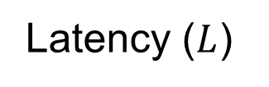
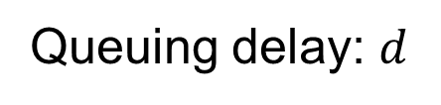
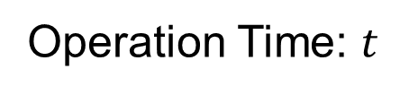
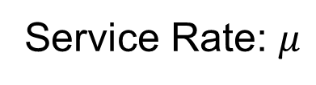
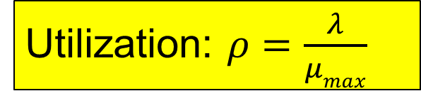
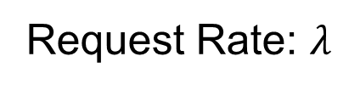
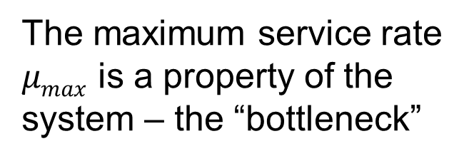
A Simple Systems Performance Model
Request Rate: $λ$
Latency ($L$)
Queuing delay: $d$
Operation Time: $t$
The maximum service rate $μmax$ is a property of the system – the “bottleneck”
Service Rate: $μ$
Utilization: $ρ=\frac{λ}{μmax}$

Slide 42
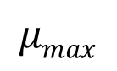
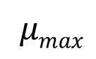
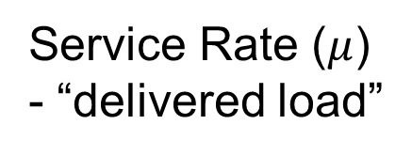
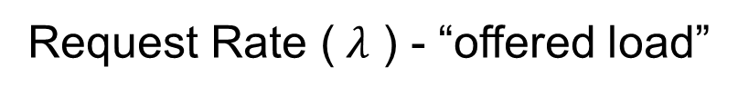
Ideal System Performance
How does $μ$ (service rate) vary with $λ$ (request rate)?
asymptotic peak rate
$$μmax$$
Service Rate ($μ$) - “delivered load”
$$μmax$$
Request Rate ($λ$ ) - “offered load”

Slide 43
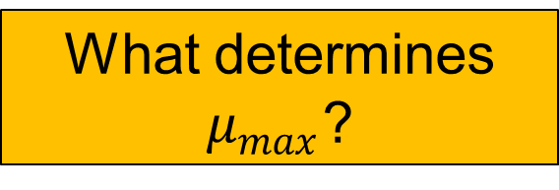
Two Related Questions
Request Rate: $λ$
Latency ($L$)
What about “internal” queues?
Queuing delay: $d$
Operation Time: $t$
The maximum service rate $μmax$ is a property of the system – the “bottleneck”
What determines $μ_{max}$?
Service Rate: $μ$
Utilization: $ρ=\frac{λ}{μmax}$

Slide 44
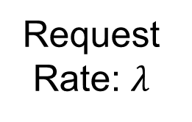
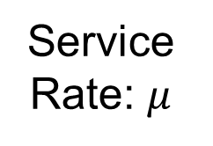
Bottleneck Analysis
L
L
L
L
L
L
L
…
time
Request Rate: $λ$
Service Rate: $μ$
Overall System: Series of Stages

Slide 45
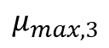
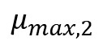
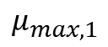
Bottleneck Analysis
Each stage has its own queue and maximum service rate
Suppose the green stage is the bottleneck
$$μ_{max,1}$$
$$μ_{max,2}$$
$$μ_{max,3}$$
Request Rate: $λ$
Service Rate: $μ$
Overall System: Series of Stages

Slide 46
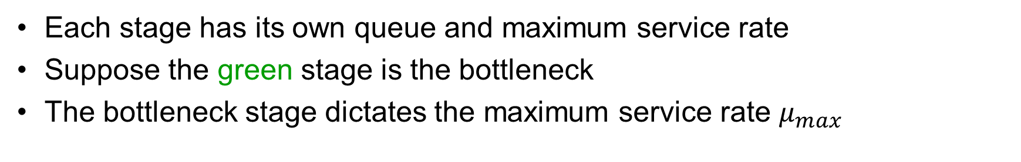
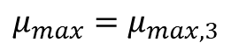
Bottleneck Analysis
Each stage has its own queue and maximum service rate
Suppose the green stage is the bottleneck
The bottleneck stage dictates the maximum service rate $μ_{max}$
$$μ_{max}=μ_{max,3}$$
Request Rate: $λ$
Service Rate: $μ$
System Model: Bottleneck Stage

Slide 47
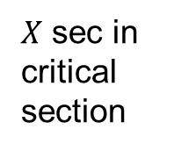
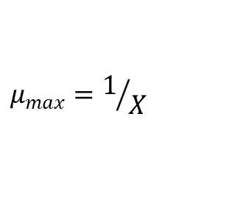
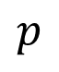
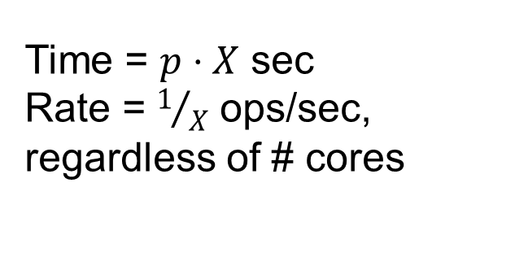
Example: Servicing a Highly Contended Lock
Queue of waiting threads
$$p$$
$$μ_{max}=1/X$$
…
All try to grab lock
$X$ sec in critical section
Time = $p⋅X$ sec
Rate = $1/X$ ops/sec, regardless of # cores
Critical section guarded by lock
…

Slide 48
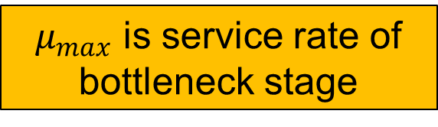
Two Related Questions
Request Rate: $λ$
Tank represents queue of bottleneck stage
Latency ($L$)
Queuing delay: $d$
Operation Time: $t$
The maximum service rate $μmax$ is a property of the system – the “bottleneck”
$μ_{max}$ is service rate of bottleneck stage
Service Rate: $μ$
Utilization: $ρ=\frac{λ}{μmax}$

Slide 49
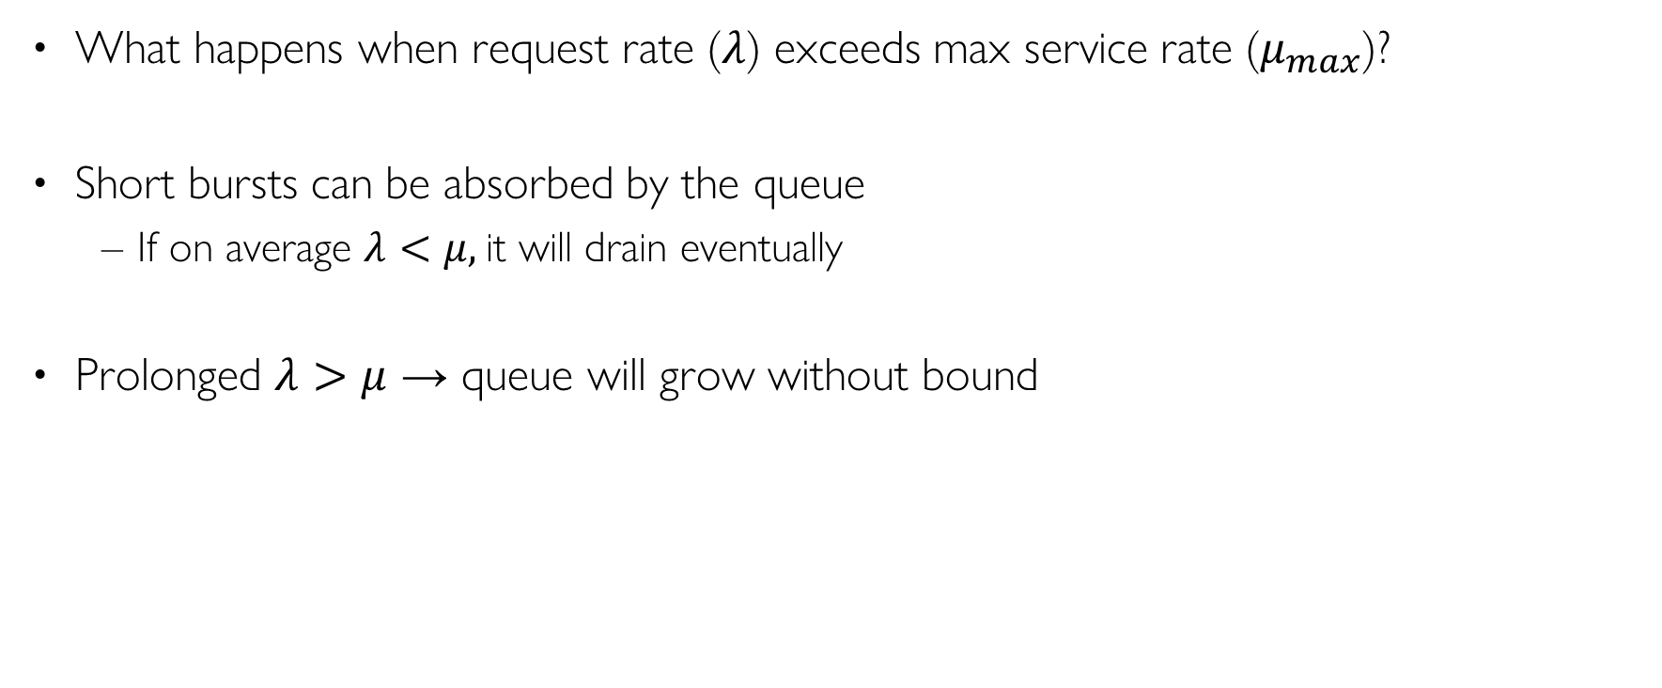
Queuing
What happens when request rate ($λ$) exceeds max service rate ($μ_{max}$)?
Short bursts can be absorbed by the queue
If on average $λ<μ,$it will drain eventually
Prolonged $λ>μ$ → queue will grow without bound

Slide 50
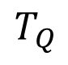
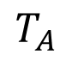
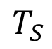
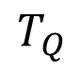
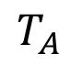
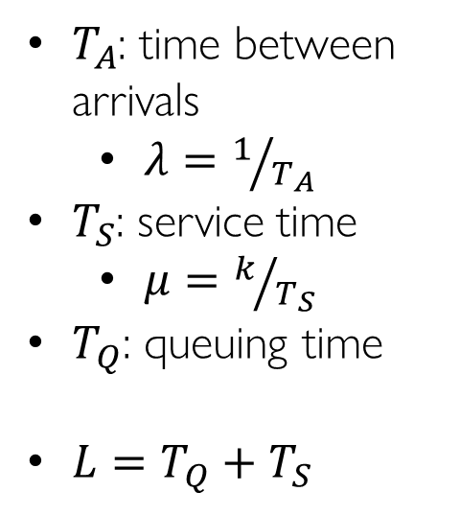

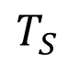
A Simple, Deterministic World
$T_{A}$: time between arrivals
$λ=1/{T_{A}}$
$T_{S}$: service time
$μ=k/{T_{S}}$
$T_{Q}$: queuing time
$L=T_{Q}+T_{S}$
arrivals
Queue
Server
departures
$$T_{Q}$$
$$T_{S}$$
$$T_{A}$$
$$T_{A}$$
$$T_{A}$$
$$T_{S}$$
$$T_{Q}$$
Assume requests arrive at regular intervals, take a fixed time to process, with plenty of time between …

Slide 51
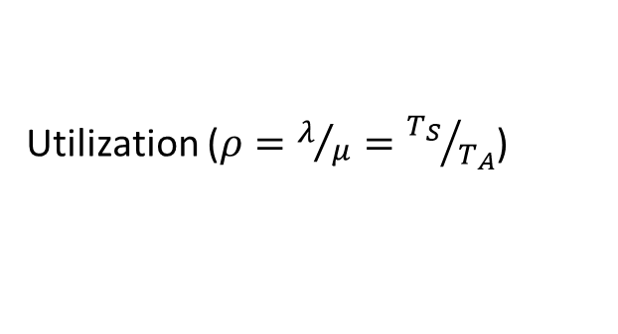

A Simple, Deterministic World
Saturation
1
1
Delivered Throughput
Delivered Throughput
Empty Queue
Unbounded
0
1
0
1
Utilization ($ρ=λ/μ={T_{S}}/{T_{A}}$)
Utilization ($ρ=λ/μ={T_{S}}/{T_{A}}$)
Queue delay
Queue delay
time
time

Slide 52



A Bursty World
$T_{A}$: time between arrivals
Now, a random variable
$T_{S}$: service time
$μ=k/{T_{S}}$
$T_{Q}$: queuing time
$L=T_{Q}+T_{S}$
arrivals
Queue
Server
departures
$$T_{Q}$$
$$T_{S}$$
Arrivals
Q depth
Server
Requests arrive in a burst, must queue up until served
Same average arrival time, but almost all of the requests experience large queue delays (even though average utilization is low)

Slide 53

How to model burstiness of arrival?
$T_{A}$, the time between arrivals, is now a random variable
Elegant mathematical framework if we model it as an exponential distribution
Probability distribution function of an exponential distribution with parameter $λ$ is $f\left(x\right)=λe^{−λx}$
“Memoryless”: Likelihood of an event occurring is independent of how long we’ve been waiting
mean arrival interval (1/λ)
Lots of short arrival intervals (i.e., high instantaneous rate)
Few long gaps (i.e., low instantaneous rate)
x (λ)

Slide 54
Steady State Queuing Theory
Arrivals
Departures
Queue
Server
Queuing System
Queuing Theory applies to long term, steady state behavior
Arrival rate = Departure rate
Arrivals characterized by some probabilistic distribution
Departures characterized by some probabilistic distribution

Slide 55

Little’s Law Applied to a Queue
When applied to a queue, we get:
Average Arrival Rate
$$L_{Q}=λT_{Q}$$
Average length of the queue
Average time “waiting”

Slide 56




Some Results from Queuing Theory
Assumptions: system in equilibrium, no limit to the queue, time between successive arrivals is random and memoryless
Queue
Server
Arrival Rate
$$λ$$
Service Rate
$$μ=1/{T_{S}}$$
$λ$: arrival rate
$T_{S}$: mean time to service a customer
$C$: squared coefficient of variance (${σ^{2}}/{T_{S}^{2}}$)
$μ$: service rate ($1/{T_{S}}$)
$ρ$: utilization ($λ/μ$)

Slide 57



Some Results from Queuing Theory
Memoryless service distribution ($C=1)$—an “M/M/1 queue”: $T_{Q}=\frac{ρ}{1−ρ}⋅T_{S}$
General service distribution (no restrictions)—an “M/G/1 queue”:
$$T_{Q}=\frac{1+C}{2}⋅\frac{ρ}{1−ρ}⋅T_{S}$$
$λ$: arrival rate
$T_{S}$: mean time to service a customer
$C$: squared coefficient of variance (${σ^{2}}/{T_{S}^{2}}$)
$μ$: service rate ($1/{T_{S}}$)
$ρ$: utilization ($λ/μ$)

Slide 58

Some Results from Queuing Theory (con’t)
$T_{Q}=\frac{ρ}{1−ρ}⋅T_{S}$ (memoryless service distribution)
$L_{Q}=λT_{Q}$ (by Little’s Law)
Utilization is $ρ=λ/{μ_{max}}=λT_{S}$, so
$L_{Q}=λT_{Q}=\frac{ρ}{T_{S}}⋅T_{Q}=\frac{ρ^{2}}{1−ρ}$ (for a single server)

Slide 59






Ideal System Performance
$T_{Q}\sim \frac{ρ}{1−ρ}$, $ρ=λ/{μ_{max}}$
Why does latency blow up as we approach 100% utilization?
Queue builds up on each burst
But very rarely (or never) gets a chance to drain
Latency ($λ$)
Service Rate ($μ$) - “delivered load”
Time
$$μmax$$
$$μmax$$
Request Rate ($λ$ ) - “offered load”

Slide 60
A Little Queuing Theory: An Example
Example Usage Statistics:
User requests 10 x 8KB disk I/Os per second
Requests & service exponentially distributed (C=1.0)
Avg. service = 20 ms (From controller+seek+rot+trans)
Questions:
How utilized is the disk?
Ans: server utilization, ρ = λT_{ser}
What is the average time spent in the queue?
Ans: T_{q}
What is the number of requests in the queue?
Ans: L_{q}
What is the avg response time for disk request?
Ans: T_{sys} = T_{q} + T_{ser}
Computation:
λ (avg # arriving customers/s) = 10/s
T_{ser} (avg time to service customer) = 20 ms (0.02s)
ρ (server utilization) = λ x T_{ser}= 10/s x .02s = 0.2
T_{q} (avg time/customer in queue) = T_{ser} x u/(1 – u) = 20 x 0.2/(1-0.2) = 20 x 0.25 = 5 ms (0 .005s)
L_{q} (avg length of queue) = λ x T_{q}=10/s x .005s = 0.05
T_{sys} (avg time/customer in system) =T_{q} + T_{ser}= 25 ms

Slide 61
Conclusion
Two types of storage devices:
HDDs, which are organized as a set of platters split into tracks, which are being spinned by a motor. HDDs have suffer from rotational delay and high seek latency
SDDs are built on top of flash technology. Flash offers three operations: read, write, program
SDDs do not suffer from seek/rotation delay but suffer from wear out.
Performance
Bottleneck & queueing delay
Model arrival/departure rate as probability distributions

